Slide 1
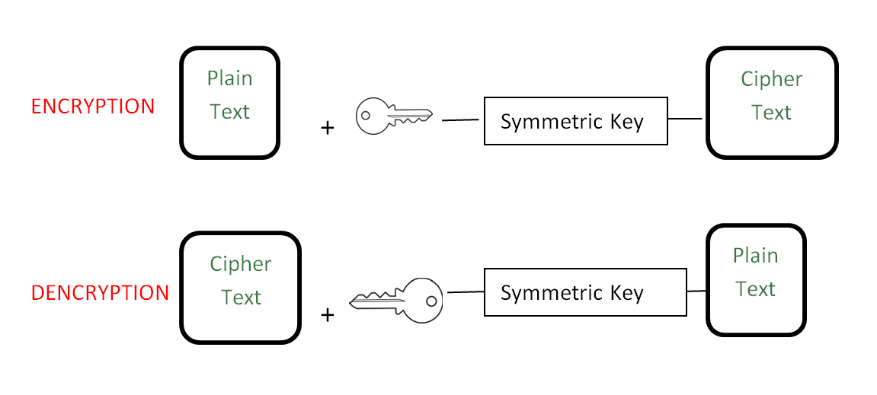
which mean “secret writing”.
It is a way to protect the information that is transmitting through the network communication path.
CRYPTOGRAPHY ?

Slide 2


VISUAL CRYPTOGRAPHY
It is the same technique but we apply on the visual pictures ,videos
in order to secure them.

Slide 3
ALGORITHM USED
Two Algorithms used :
XOR
AES(Advance Encryption Standard)
XOR: (Enc/dec)
IMAGE BYTEARRAY XOR OP ENC IMAGE(encrypt.)
ENC IMAGE BYTEARRAY XOR OP IMAGE(decrypt.)

Slide 4
AES :
Advanced Encryption Standard (AES) is a specification for the encryption of electronic data established by the U.S National Institute of Standards and Technology (NIST) in 2001.
AES is a block cipher.
The key size can be 128/192/256 bits.(16/24/32 int bytes)
Encrypts data in blocks of 128 bits each.
AES performs operations on bytes of data rather than in bits. Since the block size is 128 bits, the cipher processes 128 bits (or 16 bytes) of the input data at a time.
128 bit key – 10 rounds
192 bit key – 12 rounds
256 bit key – 14 rounds

Slide 5
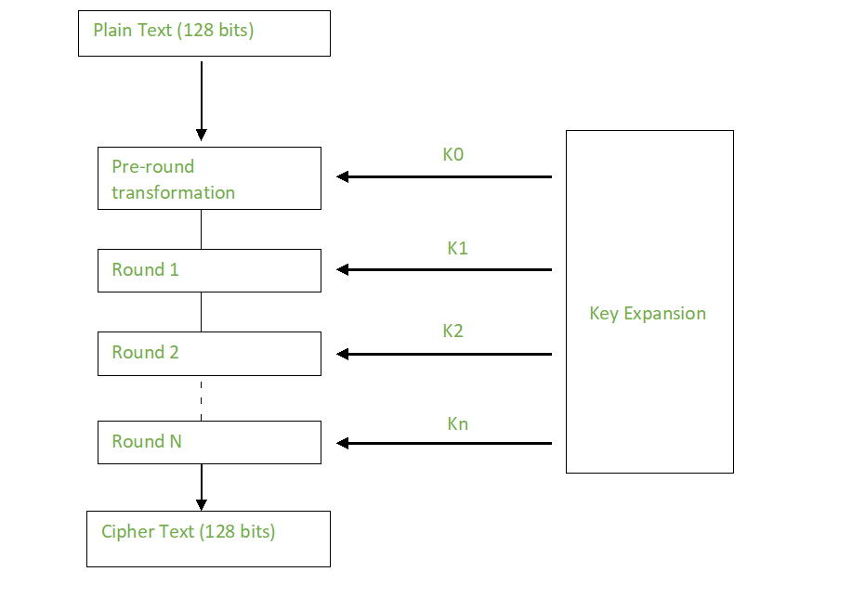
CREATION OF ROUND KEY :
A Key Schedule algorithm is used to calculate all the round keys from the given key

Slide 6
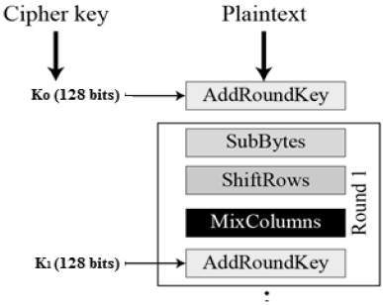
AES ENCRYPTION:
SubBytes
ShiftRows
MixColumns
Add Round Key

Slide 7
AES DECRYPTION:
The stages of each round in decryption is as follows :
Add round key
Inverse MixColumns
ShiftRows
Inverse SubByte
The decryption process is similar as encryption process but done in reverse order.

Slide 8
BOTH XOR AND AES ONE BY ONE: (ENCRYPTION)
IMAGE
(XOR enc.)
IMAGE BYTEARRAY XOR OP ENC IMAGE(encrypt.)
(AES enc.)
ENCRYPTED IMAGE

Slide 9
DECRYPTION:
ENC_IMG
AES DECRYPTION
XOR DECRYPTION
REAL_IMG

Slide 10
THANK YOU

